Slide 1

Chris Booth
John Reese
Kevin Tarchenski
Kyle Tirak

Slide 2
Agenda
Domain
Static Model
  Sigs
  Relations
  Facts
  Fascinating states
Dynamic Model
  Before & After
  Predicates
Notes:
Kevin

Slide 3
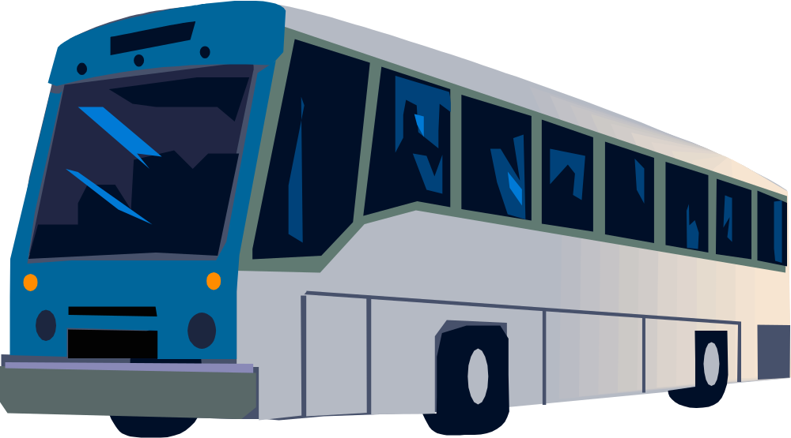
Domain
Our system models a bus system based on locations around the RIT campus
Notes:
Kevin

Slide 4
Signatures
Passengers
Buses
Routes
Locations
Stops
Times
BusStates
Notes:
John

Slide 5
Relations
sig Passenger {
destination : one Locations
}
sig Locations {
waiters : set Passenger
}
sig Routes {
stops : seq Stops
}
sig Bus {
passengers : set Passenger,
route : one Routes,
state : one BusStates
}
sig Stops {
place : one Locations,
time : one Times
}
Notes:
John

Slide 6
Facts
Buses have a maximum capacity for passengers
Passengers can only be in one place at a time (waiting at a stop/on a bus)
A bus can only be in one place at a time (at a stop/in transit)
A route consists of at least 2 stops
Stops are not in the same route twice
A bus can only stop at stops in the route it is on
Times increase as stops do on a route
Notes:
John

Slide 7
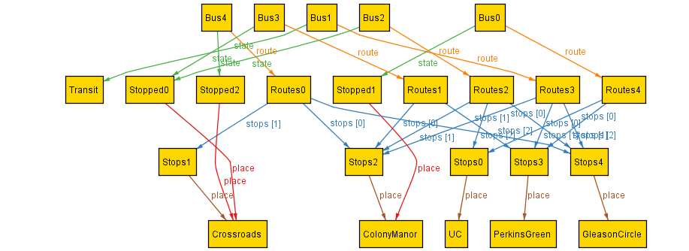
State: No Passengers
Notes:
Kyle

Slide 8
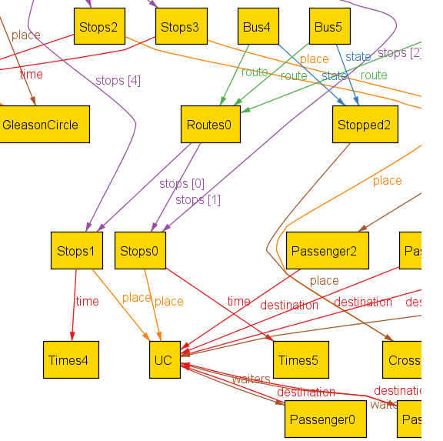
State: One Location Route
Notes:
Kyle

Slide 9
Making Dynamic
sig Bus {
passengers : Passenger -> Step,
route : one Routes,
state : BusStates one -> Step
}
sig Locations {
waiters : Passenger -> Step
}
sig Bus {
passengers : set Passenger,
route : one Routes,
state : one BusStates
}
sig Locations {
waiters : set Passenger
}
Notes:
Chris

Slide 10
Making Dynamic (preds)
Init:
  No passengers on buses
  No passengers at their destinations
Boarding:
  Takes a waiting passenger at a location with a stopped bus and puts him on the bus
  Boarder’s destination exists with bus’ route
Deboarding:
  Takes a bus passenger off a stopped bus whose location is his destination
Notes:
Chris

Slide 11
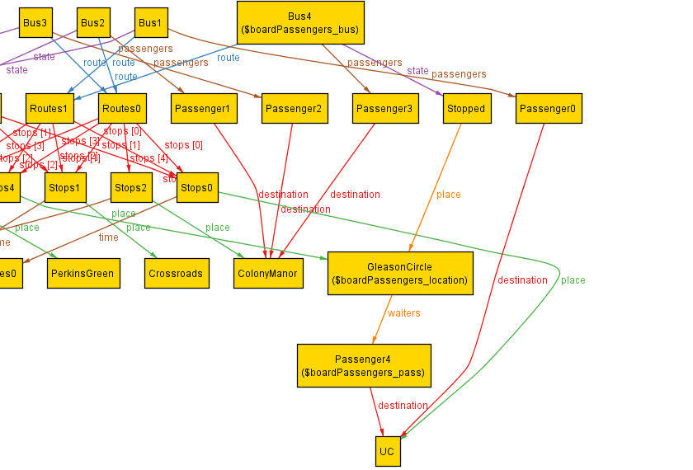
Boarding: Before
Notes:
Kyle

Slide 12
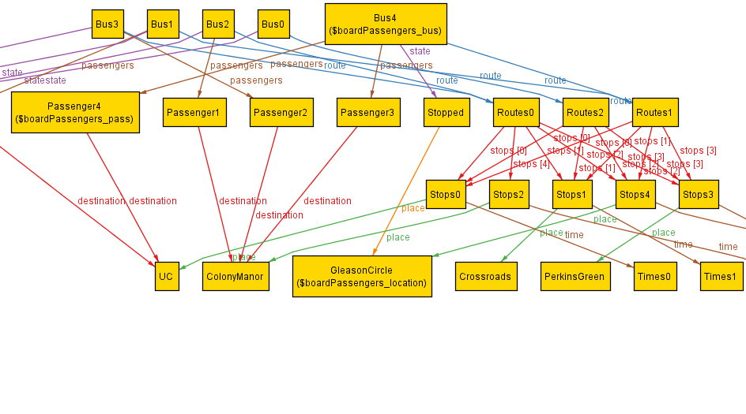
Boarding: After
Notes:
Kyle

Slide 13


